Slide 1
Chapter 6 Registers and Counter
The filp-flops are essential component in clocked sequential circuits.
Circuits that include filp-flops are usually classified by the function they perform. Two such circuits are registers and counters.
An n-bit register consists of a group of n flip- flops capable of storing n bits of binary information.

Slide 2
6-1 Registers
In its broadest definition, a register consists a group of flip-flops and gates that effect their transition.
The flip-flops hold the binary information.
The gates determine how the information is transferred into the register.
Counters are a special type of register.
A counter goes through a predetermined sequence of states.

Slide 3
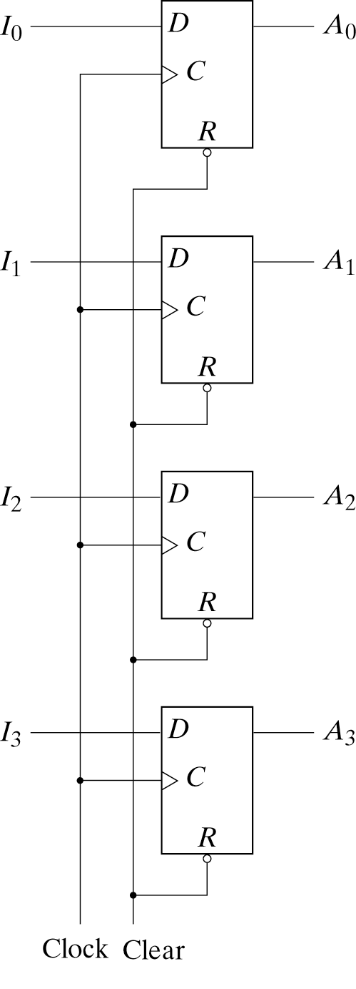
6-1 Registers
Fig 6-1 shows a register constructed with four D-type filpflops.
“Clock” triggers all flip- folps on the positive edge of each pulse.
“Clear” is useful for clearing the register to all 0’s prior to its clocked operation.

Slide 4
Register with Parallel Load
A clock edge applied to the C inputs of the register of Fig. 6-1 will load all four inputs in parallel.
For synchronism, it is advisable to control the operation of the register with the D inputs rather than controlling the clock in the C inputs of the flip-flops.
A 4-bit register with a load control input that is directed through gates and into the D inputs of the flip-flops si shown in Fig. 6-2.

Slide 5
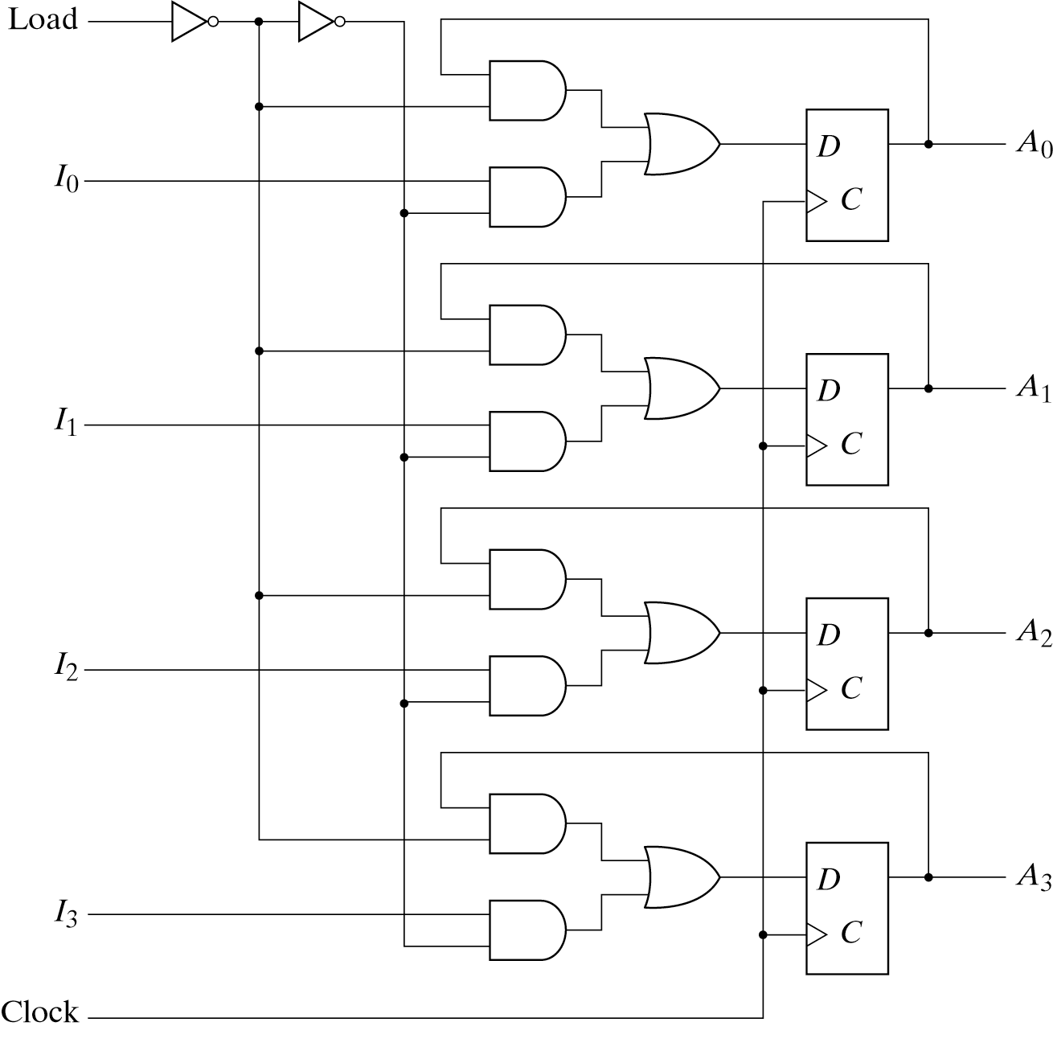
Register with Parallel Load

Slide 6
Register with Parallel Load
When the load input is 1 , the data in the four inputs are transferred into the register with next positive edge of the clock.
When the load input is 0 ,the outputs of the flip-flops are connected to their respective inputs.
The feedback connection from output to input is necessary because the D flip-flops does not have a “no change” condition.

Slide 7
6-2 Shift Registers
A register capable of shifting its binary information in one or both direction is called a shift register.
All flip-flops receive common clock pulses, which activate the shift from one stage to the next.
The simplest possible shift register is one that uses only flip-flops, as shown in Fig. 6-3

Slide 8
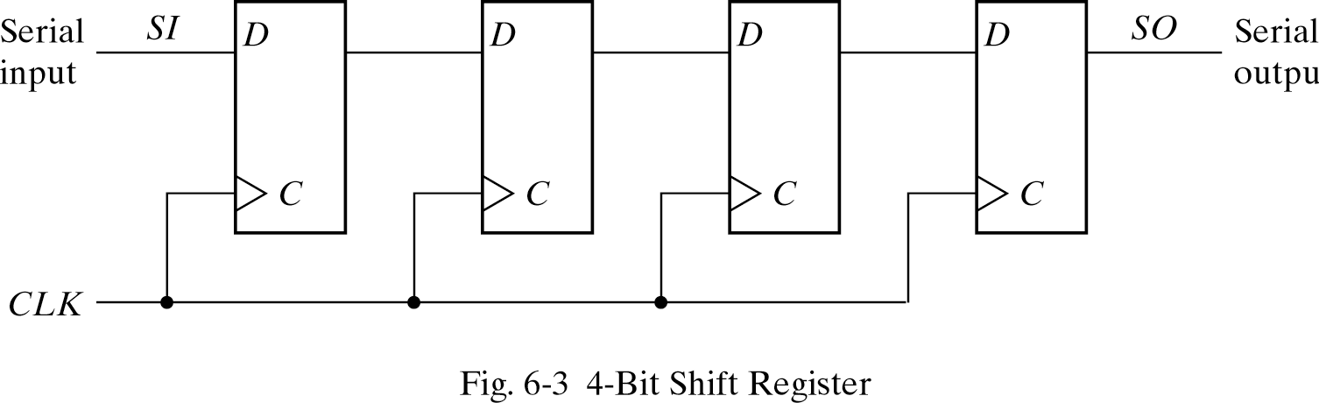
Shift Registers

Slide 9
Shift Registers
Each clock pulse shifts the contents of the register one bit position to the right.
The serial input determines what goes into the leftmost flip-flop during the shift.
The serial output is taken from the output of the rightmost flip-flop.

Slide 10
Serial Transfer
A digital system is said tp operate in a serial mode when information is transferred and manipulated one bit at a time.
This in contrast to parallel transfer where all the bits of the register are transferred at the same time.
The serial transfer us done with shift registers, as shown in the block diagram of Fig. 6-4(a).

Slide 11
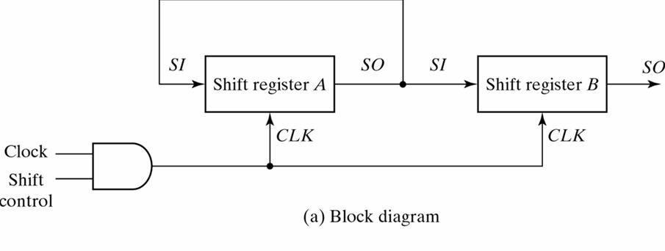
Serial Transfer

Slide 12
Serial Transfer
To prevent the loss of information stored in the source register, the information in register A is made to circulate by connecting the serial output to its serial input.
The shift control input determines when and how many times the registers are shifted. This is done with an AND gate that allows clock pulses to pass into the CLK terminals only when the shift control is active. [Fig. 6- 4(a)].

Slide 13
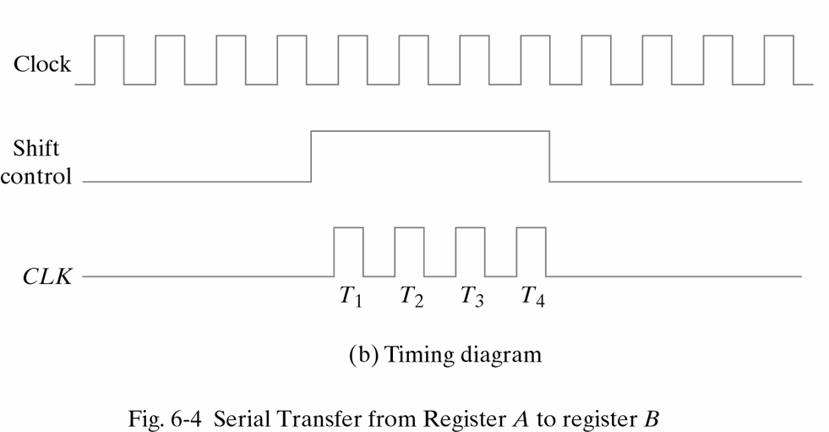
Serial Transfer

Slide 14
Serial Transfer
The shift control signal is synchronized with the clock and changes value just after the negative edge of the clock.
Each rising edge of the pulse causes a shift in both registers. The fourth pulse changes the shift control to 0 and the shift registers are disabled.

Slide 15
Serial Transfer
Table 6-1
Serial-Transfer Example
Timing Pulse | Shift Register A | Shift Register B
Initial value | 1 0 1 1 | 0 0 1 0
After T1 | 1 1 0 1 | 1 0 0 1
After T2 | 1 1 1 0 | 1 1 0 0
After T3 | 0 1 1 1 | 0 1 1 0
After T4 | 1 0 1 1 | 1 0 1 1

Slide 16
Serial Transfer
In the parallel mode, information is available from all bits can be transferred simultaneously during one clock pulse.
In the serial mode, the registers have a single serial input and a single serial output. The information us transferred one bit at a time while the registers are shifted in the same direction.

Slide 17
Serial Addition
Operations in digital computers are usually done in parallel because this is a faster mode of operation.
Serial operations are slower, but have the advantage of requiring less equipment.
The two binary numbers to be added serially are stored in two shift registers.
Bits are added one pair at a time through a single full adder. [Fig. 6-5]

Slide 18
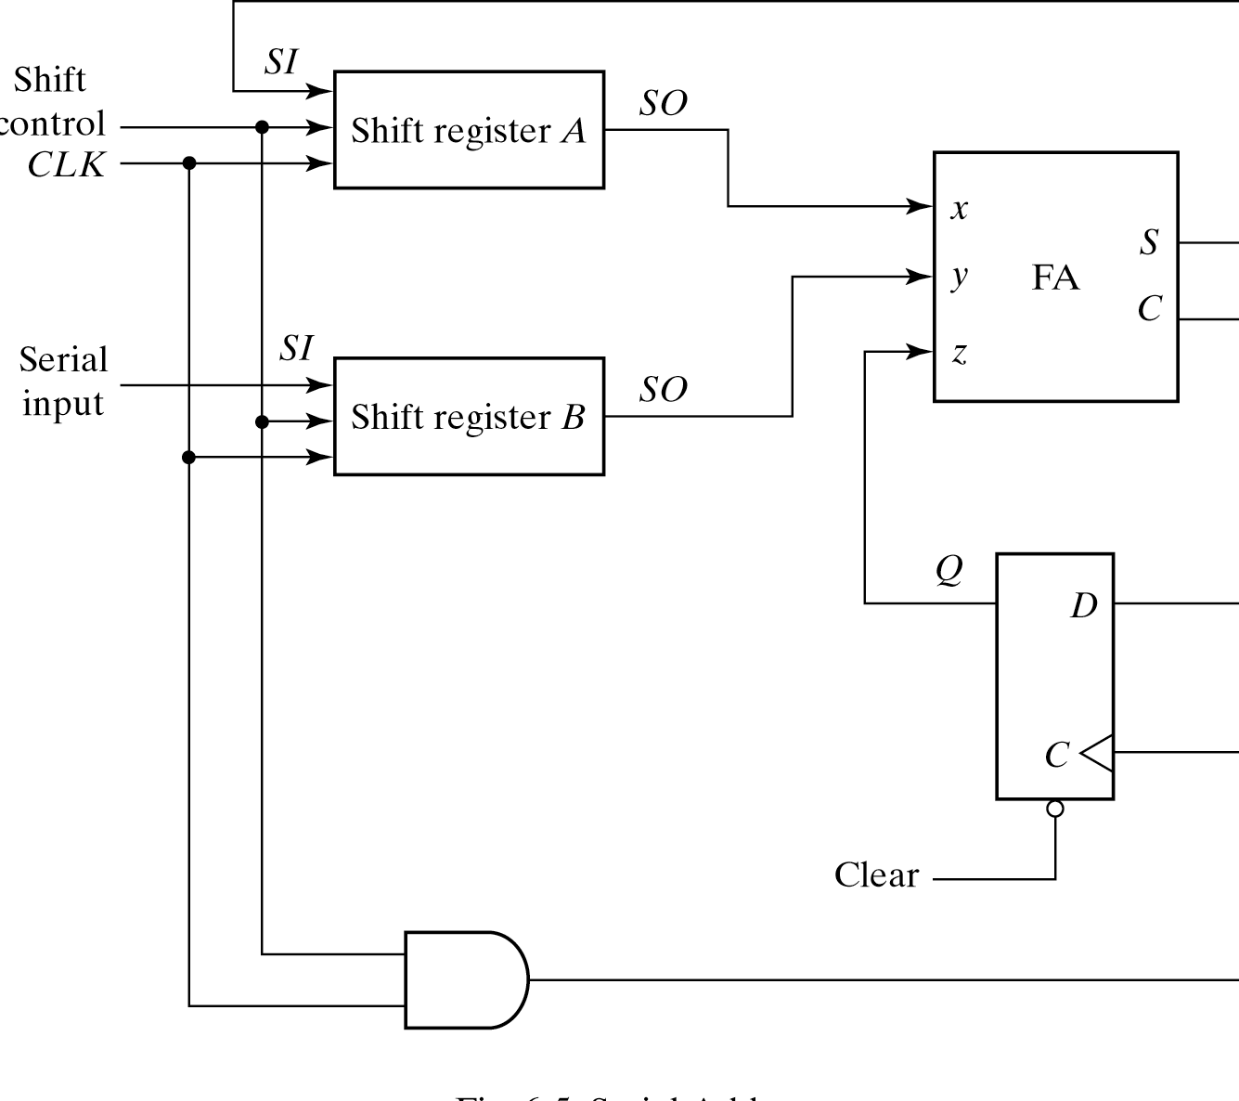
Serial Addition

Slide 19
Serial Addition
By shifting the sum into A while the bits of A are shifted out, it is possible to use one register for storing both the augend and sum bits.
The carry out of the full adder is transferred to a D flip-flop.
The output of the D flip-flop is then used as carry input for the next pair of significant bits.

Slide 20
Serial Addition
To show that serial operations can be designed by means of sequential circuit procedure, we will redesign the serial adder using a state table.
The serial outputs from registers are designated by x and y.
The sequential circuit proper has two inputs, x and y, that provide a pair of significant bits, an output S that generates the sum bit, and flip-flop Q for storing the carry. [Table. 6-2]

Slide 21
Serial Addition
Table 6-2
State Table for serial Adder
Present State | Inputs |  | Next State | Output | Flip-Flop Inputs
Q | X | y | Q | S | J_{Q} K_{Q}
0 | 0 | 0 | 0 | 0 | 0 X
0 | 0 | 1 | 0 | 1 | 0 X
0 | 1 | 0 | 0 | 1 | 0 X
0 | 1 | 1 | 1 | 0 | 1 X
1 | 0 | 0 | 0 | 1 | X 1
1 | 0 | 1 | 1 | 0 | X 0
1 | 1 | 0 | 1 | 0 | X 0
1 | 1 | 1 | 1 | 1 | X 0

Slide 22
Serial Addition
The two flip-flop input equations and the output equation can be simplified by means of map to obtain
JQ=xy
KQ=x’y’=(x+y)’
S=x⊕y⊕Q
The circuit diagram is shown in [Fig. 6-6]

Slide 23
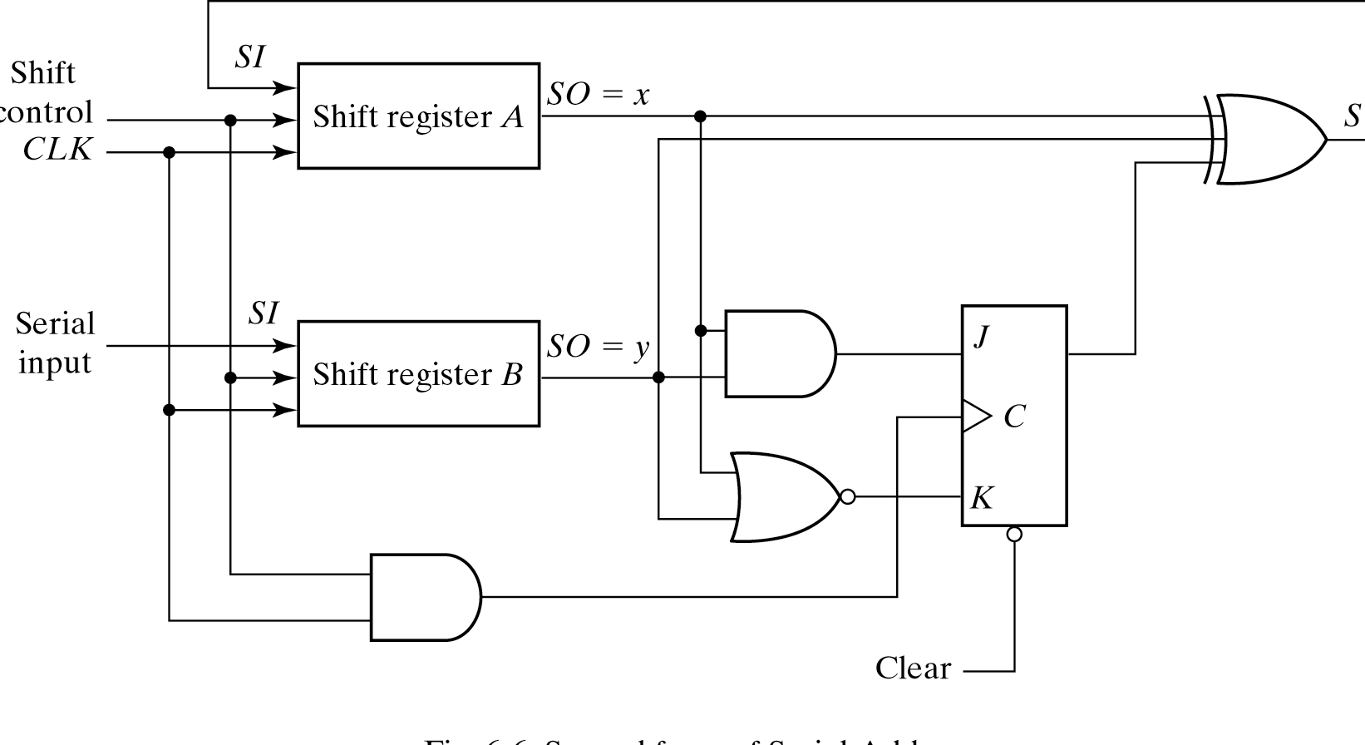
Serial Addition

Slide 24
Universal Shift Register
A clear control to clear the register to 0.
A clock input to synchronize the operations.
A shift-right control to enable the shift operation and the serial input and output lines associated with the shift right.
A shift-left control to enable the shift operation and the serial input and output lines associated with the shift left.

Slide 25
Universal Shift Register
A parallel-load control to enable a parallel transfer and the n input lines associated with the parallel transfer.
n parallel output lines.
A control state that leaves the information in the register unchanged in the presence of the clock.
If the register has both shifts and parallel load capabilities, it is referred to as a universal shift register.

Slide 26
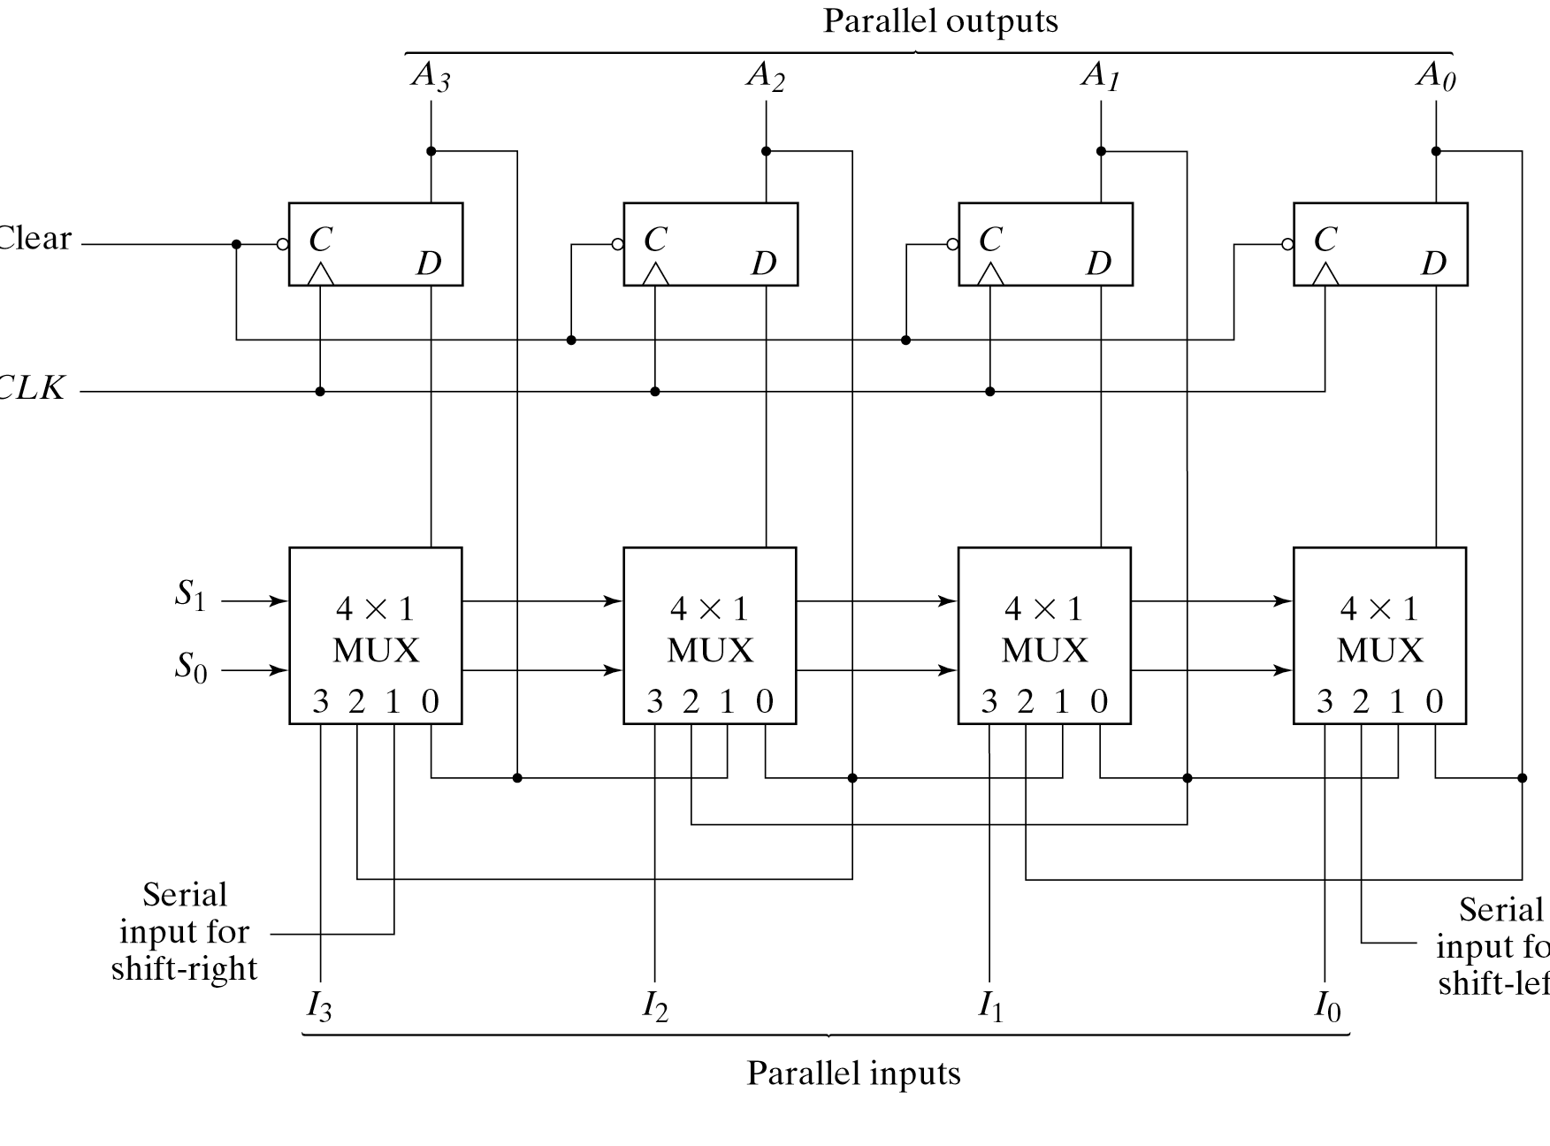
Universal Shift Register

Slide 27
Universal Shift Register
Table 6-3
Function Table for the Register of Fig. 6-7
Mode Control
S₁ | S₀ | Register Operation
0 | 0 | No Change
0 | 1 | Shift right
1 | 0 | Shift Left
1 | 1 | Parallel load

Slide 28
Universal Shift Register
Shift registers are often used to interface digital system situated remotely from each other.
If the distance is far, it will be expensive to use n lines to transmit the n bits in parallel.
Transmitter performs a parallel-to-serial conversion of data and the receiver does a serial-to-parallel conversion.

Slide 29
6-3 Ripple Counters
A register that goes through a prescribed sequence of states upon the application of input pulse is called a counter.
A counter that follows the binary number sequence is called a binary counter.
Counters are available in two categories
Ripple counters
Synchronous counters

Slide 30
Binary Ripple Counter
The output of each flip-flop is connected to the C input of the next flip-flop in sequence.
The flip-flop holding the last significant bit receives the incoming count pulse.
A complementing flip-flop can be obtained from:
JK flip-flop with the J and K inputs tied together.
T flip-flop
D flip-flop with the complement output connected to the D input. [Fig. 6-8]

Slide 31
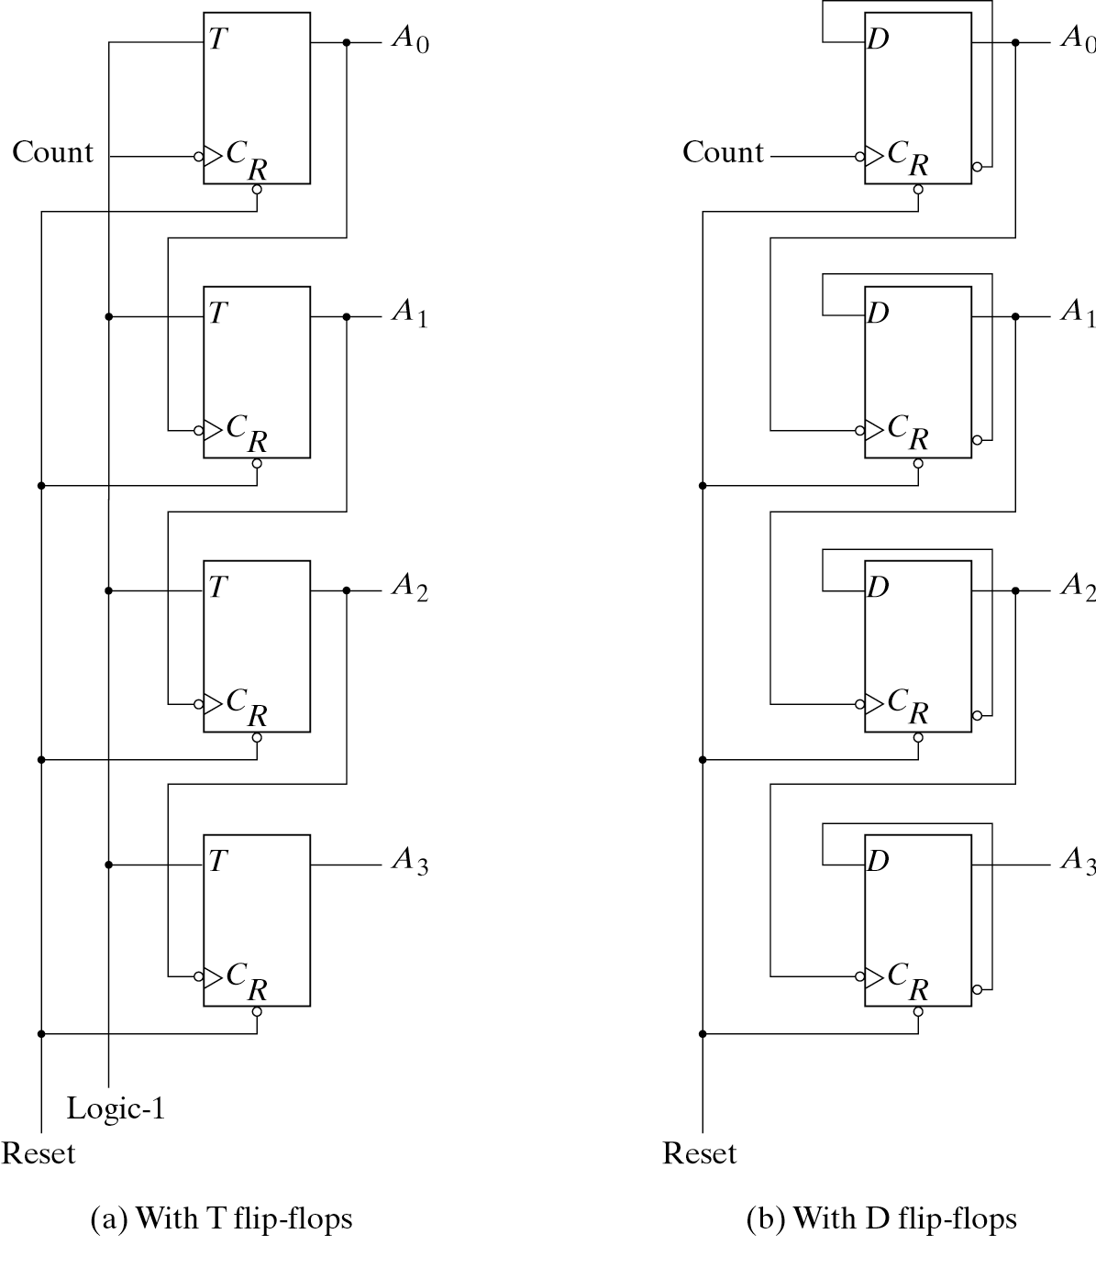
Binary Ripple Counter

Slide 32
Binary Ripple Counter
Table 6-3
Function Table for the Register of Fig. 6-7
A₃ | A₂ | A₁ | A₀
0 | 0 | 0 | 0
0 | 0 | 0 | 1
0 | 0 | 1 | 0
0 | 0 | 1 | 1
0 | 1 | 0 | 0
0 | 1 | 0 | 1
0 | 1 | 1 | 0
0 | 1 | 1 | 1
1 | 0 | 0 | 0

Slide 33
BCD Ripple Counter
A decimal counter follows a sequence of ten states and returns to 0 after the count of 9.
This is similar to a binary counter, except that the state after 1001 is 0000.
The operation of the counter can be explained by a list of conditions for flip-flop transitions.

Slide 34
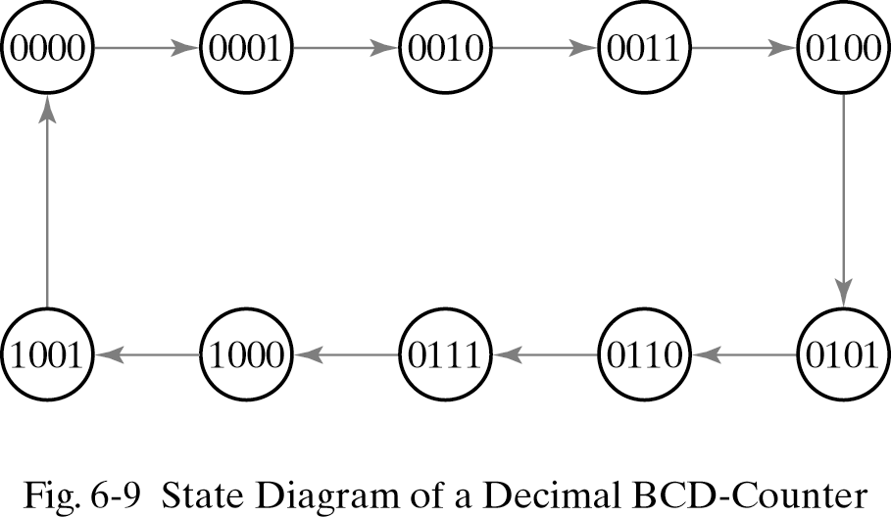
BCD Ripple Counter

Slide 35
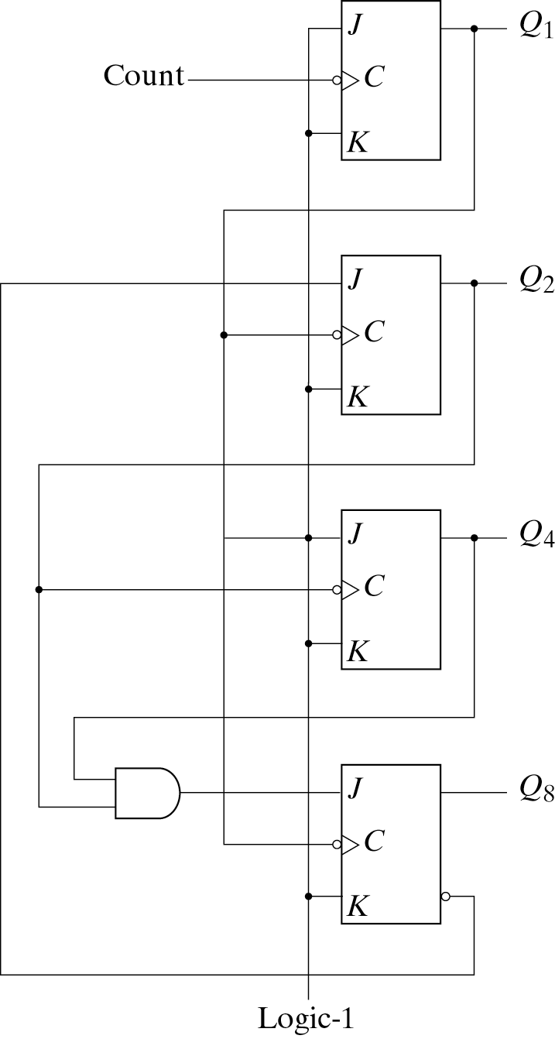
BCD Ripple Counter
The four outputs are designated by the letter symbol Q with a numeric subscript equal to the binary weight of the corresponding bit in the BCD code.

Slide 36
BCD Ripple Counter
The BCD counter of [Fig. 6-9] is a decade counter.
To count in decimal from 0 to 999, we need a three-decade counter. [Fig. 6-11]
Multiple decade counters can be constructed by connecting BCD counters ic cascade, one for each decade.

Slide 37
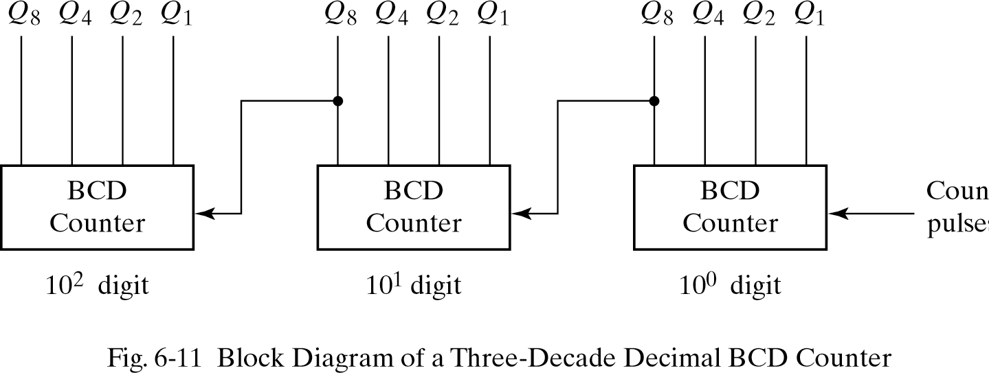
BCD Ripple Counter

Slide 38
6-4 Synchronous Counters
Synchronous counters are different from ripple counters in that clock pulses are applied to the inputs of all flip-flops.
A common clock triggers all flip-flops simultaneously rather than one at a time in succession as in a ripple counter.

Slide 39
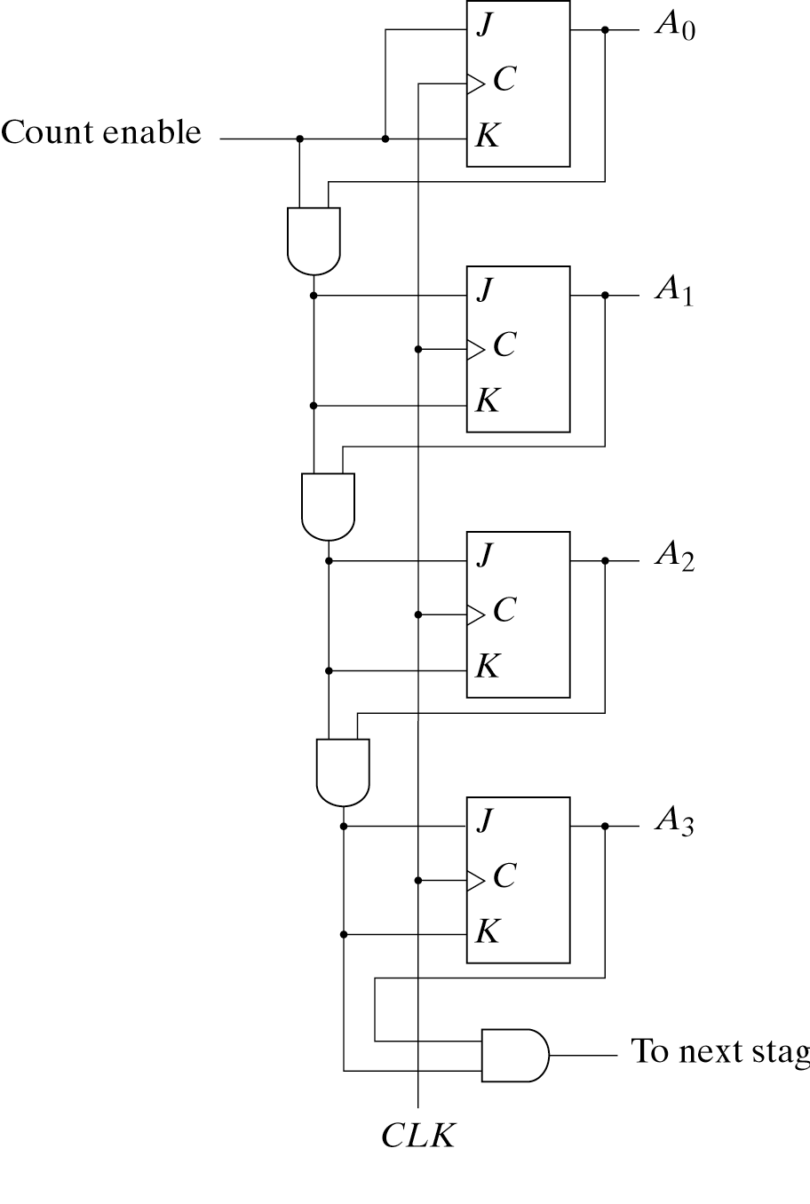
Binary Counter
The design of a synchronous binary counter is so simple that is no need to go through a sequential logic design process.
Synchronous binary counters have a regular pattern and can be constructed with complementing flip-flop and gates

Slide 40
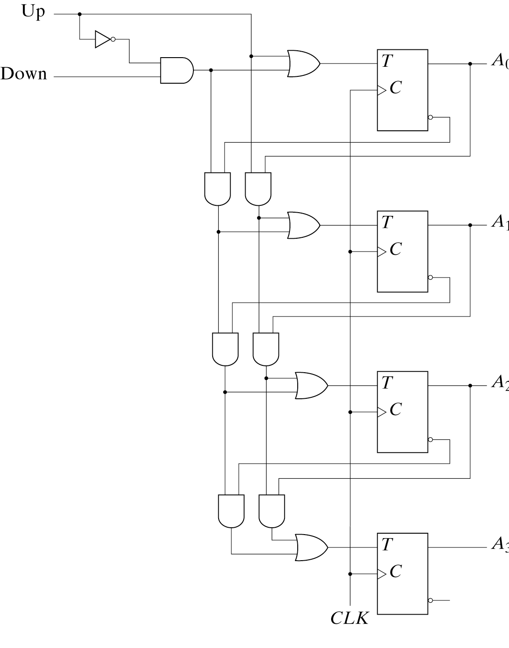
Up-Down Binary Counter
The two operations can be combined in one circuit to form a counter capable of counting up or down.
It has an up control input and down control input.

Slide 41
BCD Counter
Because of the return to 0 after a count of 9, a BCD counter does not have a regular pattern as in a straight binary count.
To derive the circuit of a BCD synchronous counter, it is necessary to go through a sequential circuit design procedure.

Slide 42
BCD Counter
Table 6-5
State Table for BCD Counter
Present State |  |  |  | Next State |  |  |  | Output | Flip-Flop inputs
Q8 | Q4 | Q2 | Q1 | Q8 | Q4 | Q2 | Q1 | Y | TQ8 | TQ4 | TQ2 | TQ1
0 | 0 | 0 | 0 | 0 | 0 | 0 | 1 | 0 | 0 | 0 | 0 | 1
0 | 0 | 0 | 1 | 0 | 0 | 1 | 0 | 0 | 0 | 0 | 1 | 1
0 | 0 | 1 | 0 | 0 | 0 | 1 | 1 | 0 | 0 | 0 | 0 | 1
0 | 0 | 1 | 1 | 0 | 1 | 0 | 0 | 0 | 0 | 1 | 1 | 1
0 | 1 | 0 | 0 | 0 | 1 | 0 | 1 | 0 | 0 | 0 | 0 | 1
0 | 1 | 0 | 1 | 0 | 1 | 1 | 0 | 0 | 0 | 0 | 1 | 1
0 | 1 | 1 | 0 | 0 | 1 | 1 | 1 | 0 | 0 | 0 | 0 | 1
0 | 1 | 1 | 1 | 1 | 0 | 0 | 0 | 0 | 1 | 1 | 1 | 1
1 | 0 | 0 | 0 | 1 | 0 | 0 | 1 | 0 | 0 | 0 | 0 | 1
1 | 0 | 0 | 1 | 0 | 0 | 0 | 0 | 1 | 0 | 0 | 0 | 1

Slide 43
BCD Counter
The flip flop input equations can be simplified by means of maps. The simplified functions are
T_{Q1}=1
T_{Q2}=Q₈’Q₁
T_{Q4}=Q₂Q₁
T_{Q8}=Q₈Q₁+Q₄Q₂Q₁
y=Q₈Q₁
The circuit can be easily drawn with four T flip-flops, five AND gates, and one OR gate.

Slide 44
Binary Counter with Parallel Load
Counters employed in digital systems quite often require a parallel load capability for transferring an initial binary number into the counter prior to count operation.
The input load control when equal to 1 disables the count operation and causes a transfer of data from the four data inputs into the four flip-flops [Fig. 6-14]

Slide 45
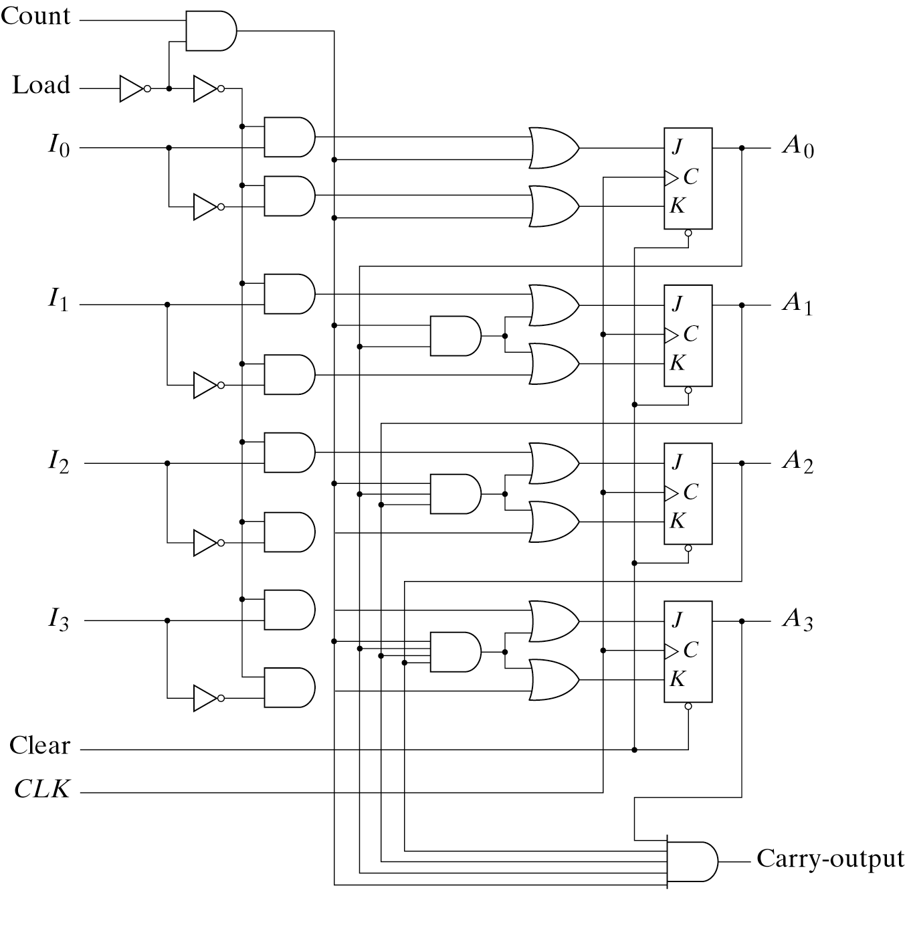
Binary Counter with Parallel Load

Slide 46
Binary Counter with Parallel Load
Table 6-6
Function Table for the Counter of Fig. 6-14
Clear | CLK | Load | Count | Function
0 | X | X | X | Clear to 0
1 | ↑ | 1 | X | Load inputs
1 | ↑ | 0 | 1 | Count next binary state
1 | ↑ | 0 | 0 | No change

Slide 47
Binary Counter with Parallel Load
A counter with parallel load can be used to generate any desire count sequence.
[Fig.6-15] shows two ways in which a counter with parallel load is used to generate the BCD count.

Slide 48
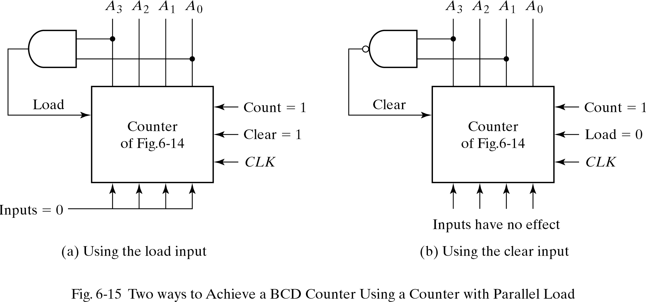
Binary Counter with Parallel Load

Slide 49
6-5 Other Counters
Counters can be designed generate any desire sequence of states.
Counters are used to generate riming signals to control the sequence of operations in a digital system.
Counters can be constructed also by means of shift registers.

Slide 50
Counter with Unused States
Once the circuit is designed and constructed, outside interference may cause the circuit to enter one of the unused state.
If the unused states are treated as don’t- care conditions, then once the circuit is designed, it must be investigated to determine the effect of the unused states
The next state from an unused state can be determined from the analysis of the circuit after it is design.

Slide 51
Counter with Unused States
Table 6-7
State Table for Counter
Present State
Next state
Flip-Flop Inputs
A | B | C |  | A | B | C |  | J_{A} | K_{A} | J_{B} | K_{B} | J_{C} | K_{C}
0 | 0 | 0 |  | 0 | 0 | 1 |  | 0 | X | 0 | X | 1 | X
0 | 0 | 1 |  | 0 | 1 | 0 |  | 0 | X | 1 | X | X | 1
0 | 1 | 0 |  | 1 | 0 | 0 |  | 1 | X | X | 1 | 0 | X
1 | 0 | 0 |  | 1 | 0 | 1 |  | X | 0 | 0 | X | 1 | X
1 | 0 | 1 |  | 1 | 1 | 0 |  | X | 0 | 1 | X | X | 1
1 | 1 | 0 |  | 0 | 0 | 0 |  | X | 1 | X | 1 | 0 | X

Slide 52
Counter with Unused States
The count has a repeated sequence of six states.
The simplified equations are:
J_{A}=B
J_{B}=C
J_{C}=B’
K_{A}=B K_{B}=1 K_{C}=1
The logic diagram and state diagram is shown in [Fig. 6-16]

Slide 53
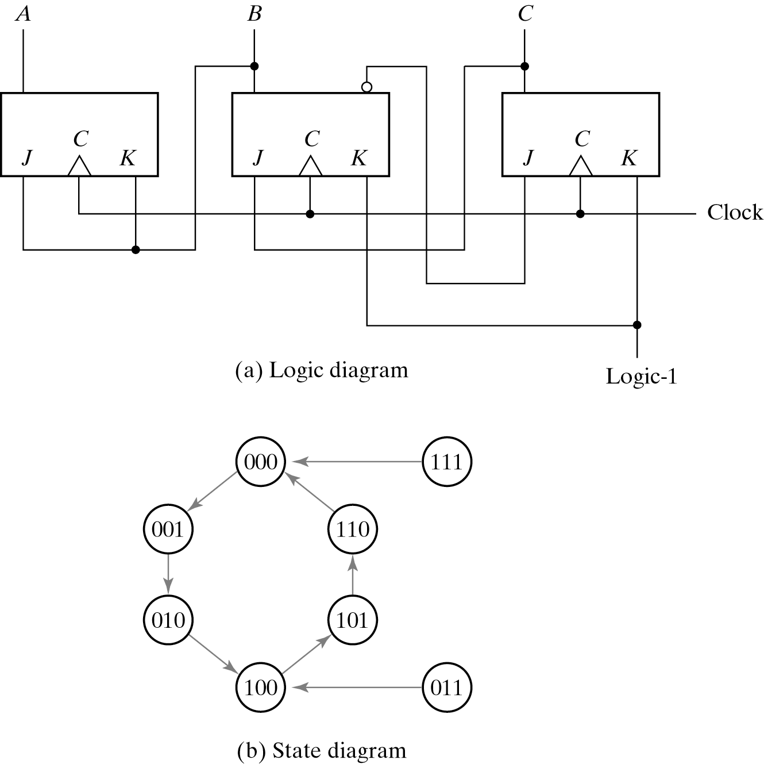
Counter with Unused States

Slide 54
Ring Counter
A ring counter is a circular shift register with only one flip-flop being set at any particular time, all others are cleared.
The single bit is shifted from one flip-flop to the next to produce the sequence of timing signals. [Fig. 6-17(a)] [Fig. 6-17(c)]
The decoder shown in [Fig. 6-17(b)] decodes the four states of the counter and generates the required sequence of timing signals

Slide 55
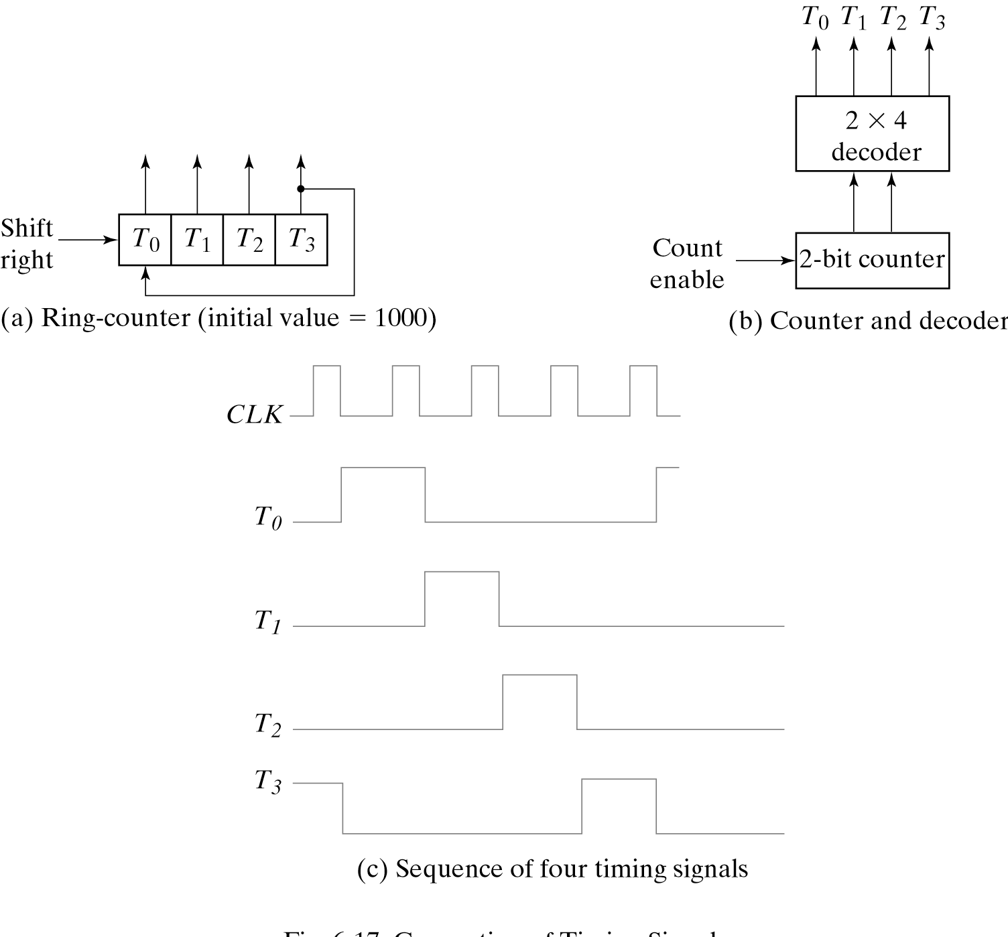
Ring Counter

Slide 56
Johnson Counter
Generate the timing signals with a combination of a shift register and a decoder which is called a Johnson counter.
The number of states can be double if the shift register is connect as a switch-tail ring counter. [Fig. 6-18(a)]
Starting from a cleared state, the switch-tail ring counter goes through a sequence of eight states, as shown in [Fig. 6-18(b)].

Slide 57
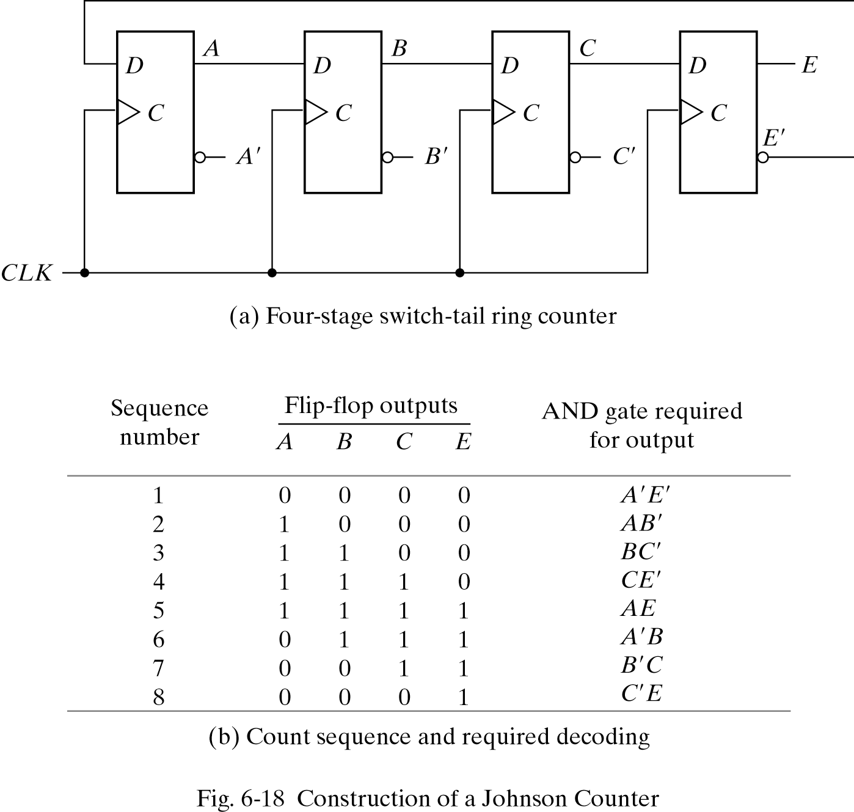
Johnson Counter

Slide 58
Johnson Counter
A Johnson counter is a k-bit switch-tail ring counter with 2k decoding gates to provide outputs for 2k timing signals.
The decoding of a k-bit switch-tail ring counter to obtain 2k timing signals follows a regular pattern.
Johnson counters can be constructed for any number of timing sequences.

Slide 59
6-6 HDL for Registers and
Counters
Registers and counters can be describe in HDL at either the behavioral or the structural level.
The various components are instantiated to form a hierarchical description of the design similar to a representation of a logic diagram

Slide 60
Shift Register
//Behavioral description of universal shift register Fig. 6-7 and Table 6-3 Module shftreg (s1,s0,Pin,lfin,rtin,A,CLK,Clr);
input s1,s0 input lfin, rtin; input CLk, clr; input [3:0] Pin;
output [3:0] A;
reg [3:0] A;
always @ (posedge CLK or negedge Clr) if (~Clr) A = 4’ b0000’
else
case ({s1,s0}) 2’ b00: A = A;
2’ b01: A = {rtin,A[3:1]};
2’ b10: A = {A[2:0],lfin};
2’ b11: A =Pin;
endcase endmodule
//Select inputs
//Serial inputs
//Clock and Clear
//Parallel input
//Register output
//No change
//Shift right
//Shift left
//Parallel load input
60

Slide 61
Shift Register
//Structural description of Universal shift register(see Fig.6-7) module SHFTREG (I,select,lfin,rtin,A,CLK,Clr);
input [3:0] I;
input [1:0] select; input lfin,rtin,CLK,Clr; output [3:0] A;
//Parallel input
//Mode select
//Serial inputs,clock,clear
//Parallel output
//Instantiate the four stages
stage stage | ST0 ST1 | (A[0],A[1],lfin,I[0],A[0],select,CLK,Clr); (A[1],A[2],A[0],I[1],A[1],select,CLK,Clr);
stage | ST2 | (A[2],A[3],A[1],I[2],A[2],select,CLK,Clr);
stage | ST3 | (A[3],rtin,A[2],I[3],A[3],select,CLK,Clr);
endmodule
61

Slide 62
Shift Register
//One stage of shift register
module stage(i0,i1,i2,i3,Q,select,CLK,Clr); input i0,i1,i2,i3,CLK,Clr;
input [1:0] select;
output Q; reg Q; reg D;
//4x1 multiplexer
always @ (i0 or i1 or i2 or i3 or select) case (select)
2'b00: | D | = | i0;
2'b01: | D | = | i1;
2'b10: | D | = | i2;
2'b11: | D | = | i3;
endcase
//D flip-flop
always @ (posedge CLK or negedge Clr) if (~Clr) Q = 1'b0;
else Q = D;
62

Slide 63
Synchronous Counter
//Binary counter with parallel load See Figure 6-14 and Table 6-6 module counter (Count,Load,IN,CLK,Clr,A,CO);
input Count,Load,CLK,Clr;
input [3:0] IN; output CO; output [3:0] A;
reg [3:0] A;
//Data input
//Output carry
//Data output
assign CO = Count & ~Load & (A == 4'b1111); always @ (posedge CLK or negedge Clr)
if (~Clr) A = 4'b0000;
else | if (Load) | A = IN;
else | if (Count) | A = A + 1'b1;
else | A = A; | // no change, | default | condition
endmodule
64

Slide 64
Ripple Counter
//Ripple counter (See Fig. 6-8(b))
module ripplecounter (A0,A1,A2,A3,Count,Reset); output A0,A1,A2,A3;
input Count,Reset;
//Instantiate complementing flip-flop CF F0 (A0,Count,Reset);
CF F1 (A1,A0,Reset); CF F2 (A2,A1,Reset); CF F3 (A3,A2,Reset);
endmodule
//Complementing flip-flop with delay
//Input to D flip-flop = Q' module CF (Q,CLK,Reset);
output Q;
input CLK,Reset; reg Q;
always @ (negedge CLK or posedge Reset) if (Reset) Q = 1'b0;
else Q = #2 (~Q); // Delay of 2 time units endmodule
64

Slide 65
Ripple Counter
//Stimulus for testing ripple counter module testcounter;
reg Count; reg Reset;
wire A0,A1,A2,A3;
//Instantiate ripple counter
ripplecounter RC (A0,A1,A2,A3,Count,Reset); always
#5 Count = ~Count; initial
begin
Count = 1'b0; Reset = 1'b1;
#4 Reset = 1'b0; #165 $finish;
end endmodule
65

Slide 66
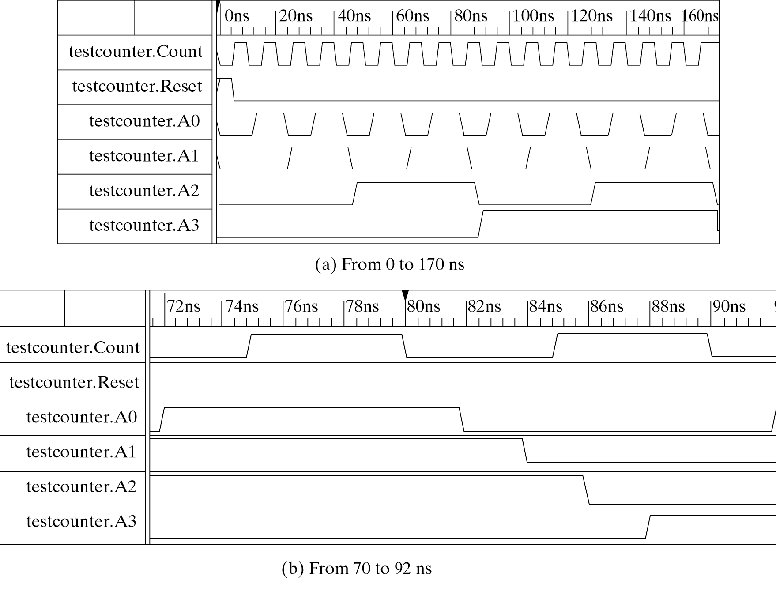
Ripple Counter
65

